Slide 1




ورشة عمل
الوسيط المركزي CCP
كأحد مكونات تطوير منظومة أسواق المال
إدارة تنظيم الأسواق
بمشاركة
ديسمبر 2018

Slide 2

Table of Content
Financial Market Infrastructures (FMIs)
Principles for Financial Market Infrastructures (PFMI)
Central Counterparty (CCP)
Post-Trade Model (PTM)

Slide 3
What is an FMI?
Multilateral system (participants)
System is run by an (operator)
Used for settlement, clearing, or recording of transactions
Rules
Procedures
Tech.
Infrastructure
Risk Management
Centralized

Slide 4





What is an FMI?
Securities Settlement Systems
(SSS)
Trade Repository
(TR)
Central Counterparty (CCP)
Central Securities Depository
(CSD)
Payments Systems
(PS)

Slide 5




Description of each FMI
 | Enables transfer and settlement of securities (book entry). Transfers can be either free of payment, or against payment. DvP is the standard for transfers against payment.
 | Provides securities accounts, central safekeeping and asset services. Can administer corporate actions. Hold securities either physically or electronically (dematerialized). May act as registrar. Key to ensuring integrity of securities issues.
 | Maintains a centralised electronic record (database) of transaction data. Grown in importance recently (OTC Derivatives). Enhances transparency.
 | Set of instruments, procedures, and rules for the transfer of funds. This system includes the entity operating the arrangement and its participants. Transfer is effected through an agreed upon payment infrastructure.
 | Interposes itself between counterparties to contracts traded in one or more financial markets. Guarantees trades through “novation” or “open offer”. Reduces risk through multilateral netting and risk controls on members.
Securities Settlement Systems
(SSS)
Central Securities Depository
(CSD)
Trade Repository
(TR)
Payments Systems
(PS)
Central Counterparty (CCP)
Today’s Focus

Slide 6




How they work together?
Exchange Member
Buy order
Sell order
Exchange Member
Exchange
Clearing agreement
Clearing agreement
Trade details
Clearing Member
Buys from CCP
Sells to CCP
Clearing Member
Novation
Novation
Central Counterparty (CCP)
Settlement details
Securities Settlement System
(SSS)
Securities transfer instructions
CSD Member
CSD Member

Slide 7
Importance of FMI’s
Safety
Risk is reduced through centralization.
FMIs play critical role in the stability of the financial system and the broader economy.
Efficiency
Cost is reduced through centralization.
Allows for introduction of risky products (enables financial innovation)

Slide 8
Table of content
Financial Market Infrastructures (FMI)
Principles for Financial Market Infrastructures (PFMI)
Central Counterparty (CCP)
Post-Trade Model (PTM)

Slide 9
Principles for Financial Market Infrastructures (PMFI)
The Principles for Financial Market Infrastructures are the international standards for financial market infrastructures (FMIs), such as CCPs.
They are issued by the Committee on Payments and Market Infrastructures (CPMI) and the International Organization of Securities Commissions (IOSCO).
The PFMI are part of a set of the standards that the international community considers essential to strengthening and preserving financial stability.
PFMIs are divided into 24 principles that apply to some or all of the infrastructure entities.

Slide 10

The Committee on Payments & Market Infrastructures (CPMI)
Global Standard Setter
Promote Safety & Efficiency
Cooperation & Coordination
Monitor & Analyze Developments

Slide 11

International Organization of Securities Commissions (IOSCO)
Objectives of Securities Regulations
Ensuring that markets are fair, efficient, and transparent
Reducing systematic risk
Protecting investors

Slide 12
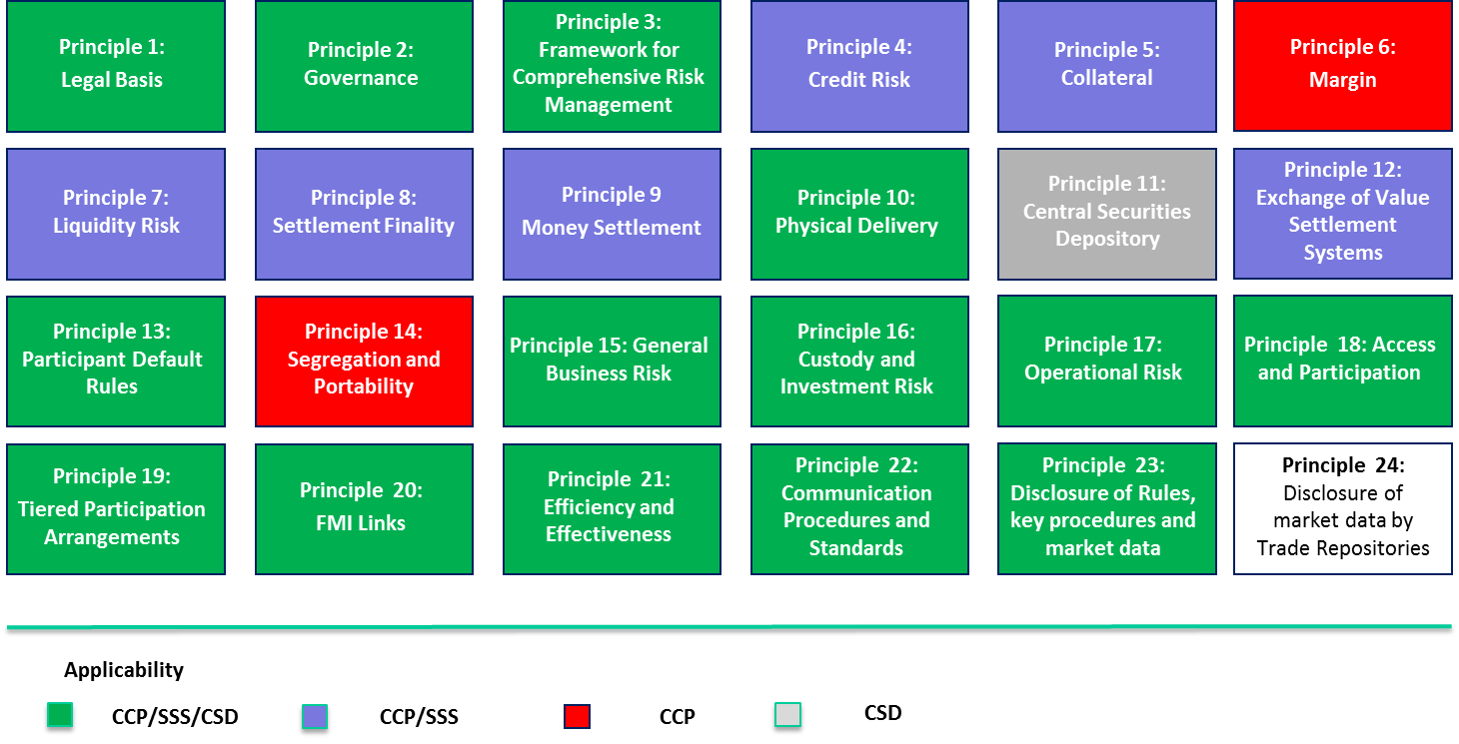
The (24) Principles for Financial Market Infrastructure

Slide 13
Principle 4: Credit Risk
An FMI should effectively measure, monitor, and manage its credit exposures to participants and those arising from its payment, clearing, and settlement processes. An FMI should maintain sufficient financial resources to cover its credit exposure to each participant fully with a high degree of confidence. In addition, a CCP that is involved in activities with a more-complex risk profile or that is systemically important in multiple jurisdictions should maintain additional financial resources sufficient to cover a wide range of potential stress scenarios that should include, but not be limited to, the default of the two participants and their affiliates that would potentially cause the largest aggregate credit exposure to the CCP in extreme but plausible market conditions. All other CCPs should maintain additional financial resources sufficient to cover a wide range of potential stress scenarios that should include, but not be limited to, the default of the participant and its affiliates that would potentially cause the largest aggregate credit exposure to the CCP in extreme but plausible market conditions.

Slide 14
Principle 5: Collateral
An FMI that requires collateral to manage its or its participants’ credit exposure should accept collateral with low credit, liquidity, and market risks. An FMI should also set and enforce appropriately conservative haircuts and concentration limits.

Slide 15
Principle 7: Liquidity Risk
An FMI should effectively measure, monitor, and manage its liquidity risk. An FMI should maintain sufficient liquid resources in all relevant currencies to effect same day and, where appropriate, intraday and multiday settlement of payment obligations with a high degree of confidence under a wide range of potential stress scenarios that should include, but not be limited to, the default of the participant and its affiliates that would generate the largest aggregate liquidity obligation for the FMI in extreme but plausible market conditions.

Slide 16
Principle 9: Money Settlements
An FMI should conduct its money settlements in central bank money where practical and available. If central bank money is not used, an FMI should minimize and strictly control the credit and liquidity risk arising from the use of commercial bank money.

Slide 17
Application of the Principles for Financial Market Infrastructures
Level 1:
Level 2:
Level 3:
Self-assessments that report on whether a jurisdiction has completed the process of adopting the legislation and other policies that will enable it to implement the PFMI
Peer reviews that assess the extent to which the content of the jurisdiction's implementation measures is complete and consistent with the PFMI.
Peer reviews that examine consistency in the outcomes of implementation of the PFMI

Slide 18
Current Status of Implementation

Slide 19
Table of content
Financial Market Infrastructures (FMI)
Principles for Financial Market Infrastructures (PFMI)
Central Counterparty (CCP)
Post-Trade Model (PTM)

Slide 20
Central Counter Party (CCP)
CCPs act as intermediaries in the markets.
A CCP interposes itself on transactions, becoming a buyer to every seller, and a seller to every buyer. In doing so, the CCP takes on the counterparty risk associated with each clearing participant, and guarantees performance of the contract should one party fail to deliver on its commitment.
To support this guarantee, the CCP has a range of financial resources drawn from clearing participants (such as margins and clearing fund contributions), its own resources (such as equity capital and retained earnings), and third parties (such as insurance).
A CCP becomes counterparty to trades with market participants through novation, an open-offer system, or through an analogous legally binding arrangement.
CCPs have the potential to reduce significantly risks to participants through the multilateral netting of trades and by imposing more-effective risk controls on all participants.

Slide 21
Benefits of CCP
The ability to mitigate counterparty credit risk and increase market confidence by reducing systemic risk and uncertainty arising from a default event. CCPs are backed by a series of capital buffers (in the form of initial margins, default fund, reserves and equity) and a risk-sharing arrangement among CCP members.
Increasing capital and balance sheet efficiency, reducing settlement obligations and systemic and liquidity risks by facilitating multilateral netting of settlements and exposures.
Enhancing the efficiency of financial markets generally, by cutting the average costs of trading and increasing the profitability of their users and the effective capacity, volume, liquidity and product innovation of the marketplace.
The potential for enhancing market transparency, given that CCPs collect data on transactions and are therefore in a position to publish aggregated price and volume data.

Slide 22
Risks of CCP
The ability to mitigate counterparty credit risk and increase market confidence by reducing systemic risk and uncertainty arising from a default event. CCPs are backed by a series of capital buffers (in the form of initial margins, default fund, reserves and equity) and a risk-sharing arrangement among CCP members.
Increasing capital and balance sheet efficiency, reducing settlement obligations and systemic and liquidity risks by facilitating multilateral netting of settlements and exposures.
Enhancing the efficiency of financial markets generally, by cutting the average costs of trading and increasing the profitability of their users and the effective capacity, volume, liquidity and product innovation of the marketplace.
The potential for enhancing market transparency, given that CCPs collect data on transactions and are therefore in a position to publish aggregated price and volume data.

Slide 23
Case Study: Lehman Brothers
The collapse of one of the four largest US investment banks, Lehman Brothers, in late 2008 precipitated a one-day fall of around five per cent in major equity market indices, and falls of around ten per cent in major banking stocks as well as volatility in yields and credit spreads.
During this time central counterparties around the world assumed Lehman Brothers’ market positions as the bank defaulted on its obligations.
Despite the massive market turmoil, central counterparties unwound, hedged, liquidated, and transferred millions of positions and client accounts worth trillions of dollars largely without loss, providing increased stability and certainty to already fragile markets.
Ex: LCH.Clearnet (UK) and DTCC (US)

Slide 24
Case Study: Lehman Brothers
LCH.Clearnet
The London-based clearinghouse LCH.Clearnet was exposed, through Lehman’s interest rate swap portfolio, to the risk of sharp market movements across a wide range of products.
The total notional value of the portfolio was $9 trillion, encompassing a total of 66,390 trades across five major currencies.
The unwinding process was achieved through the competitive auctioning of the Lehman OTC interest rate swap portfolio.
The default was managed well within the margins posted by Lehman, and LCH.Clearnet did not have to resort to its default fund.

Slide 25
Case Study: Lehman Brothers
The Depository Trust and Clearing Corporation (DTCC)
DTCC, the largest clearing agent for the U.S., announced in October 2008 that it had successfully closed out over $500 billion in market participants’ exposure from the Lehman Brothers bankruptcy.
The unwinding process was carried out by netting Lehman’s positions and liquidating any remaining positions, by asset class.
DTCC’s Fixed Income Clearing Corporation (FICC) had plans to launch a CCP that could net mortgage-backed securities. Although it was not in operation at the time of Lehman’s bankruptcy, the FICC put the idea to work and netted out $300 billion in Lehman trades related to mortgage-backed securities.
Subsidiaries of DTCC processed $3.8 billion in options exercises and assignments that were expiring and arranged for the release of $1.9 billion in securities with Lehman’s bank to satisfy Lehman’s open trades. The remaining positions were liquidated in the market.
The unwinding process was therefore conducted swiftly and without resorting to DTCC’s subsidiaries’ default funds.

Slide 26








Three Clearing Membership Models
General, direct,
non-clearing members
Clearing and
non-clearing members
Trading and non-trading clearing members
1
2
3
Description
General clearing member (GCM): clears his trades, those of his clients as well as those of non-clearing members
Direct clearing member (DCM): clears his trades and those of his clients
Non-clearing member (NCM): Clears his trades and those of his clients through a general clearing member
Clearing member: clears his own trade, trades of his clients and non-clearing members
Non-clearing member: clears all trades through a clearing member
Trading clearing member (TCM): clears own and client trades
Non-trading clearing member (NTCM): clears client trades
Ex:
Source: CCP websites and rulebook

Slide 27
Clearing Membership Structure
Clearing membership structure for securities
For cash settlement some DCM's may need to go through a settlement bank
CCP
CCP
Direct settlement
Settlement bank
Direct clearing member (DCM)
General clearing member (GCM)
Direct settlement
GCM
DCM - A
DCM - B
GCM should be eligible for central bank account
Non clearing member (NCM)
DCM with no account with central bank using 3rd party settlement bank
DCM with at least a non-RTGS account with central bank
NCM

Slide 28
Table of Contents
Financial Market Infrastructures (FMI)
Principles for Financial Market Infrastructures (PFMI)
Central Counterparty (CCP)
Post-Trade Model (PTM)

Slide 29
Financial Market Infrastructures
FMIs and Exchange
Market Intermediaries / Members
Exchange Member
Type 1
Exchange Member
Type 2
  Exchange
  Trading
  Clearing House
  (CCP/SSF)
GCM
DCM
  Clearing /
  Settlement
  Securities Settlements
CSD Member
Type 1
CSD Member
Type 2
  Depository
  CSD
  (Central Securities Depository)
  Cash Settlements
  Payment
  RTGS
Existing

Slide 30
Clearing Members
General clearing member (GCM)
  Clears his trades, those of his clients as well as those of non-clearing members.
Direct clearing member (DCM)
  Clears his trades and those of his clients.
Non-clearing member (NCM)
  Clears his trades and those of his clients through a general clearing member.

Slide 31
Risk Watrefall
Failed Settlement
Default
Recovery and resolution principles:
Recovery initiated once all pre-funded resources in the default fund have been depleted to cover losses incurred when liquidating or transferring the defaulter’s positions.
CCP leverages a range of recovery tools, including a call for further funds from clearing members.
CCP should only be put in resolution once the CCP’s recovery process is exhausted or it is deemed by CMA to be insufficient.
Resolution of a CCP should be led by the CMA.
Loss allocation waterfall
Failing Member's Collateral for Errors
Defaulting Member's Contribution to Default Fund
Designed to cover stress scenarios
CCP Skin In
The Game
Non-defaulting Members' contributions to Default Fund
Additional
Defaulting Clearing Member's Regulatory Capital
CCP Regulatory Capital

Slide 32


شــكــراً

